Slide 1
RESTful API Design Best Practices
Using ASP.NET Web API
KCDC 2016
Spencer Schneidenbach
Ryvit

Slide 2




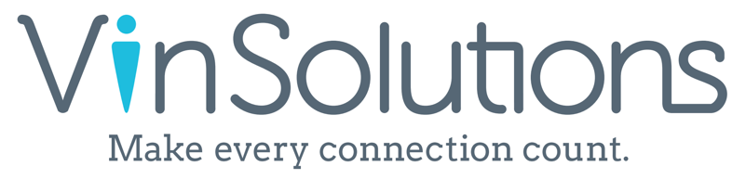




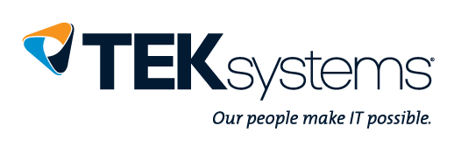










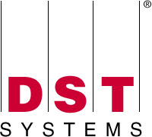
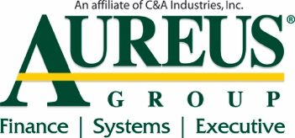

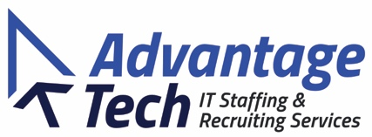
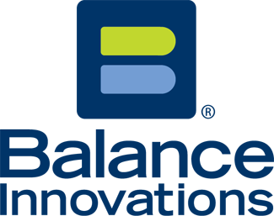




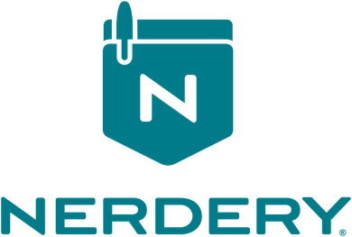
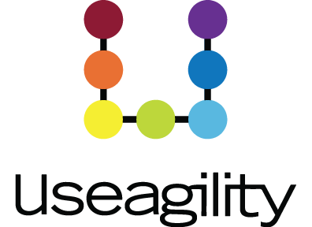
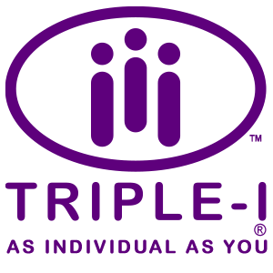

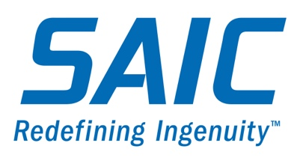



TITANIUM SPONSORS
Platinum Sponsors
Gold Sponsors

Slide 3
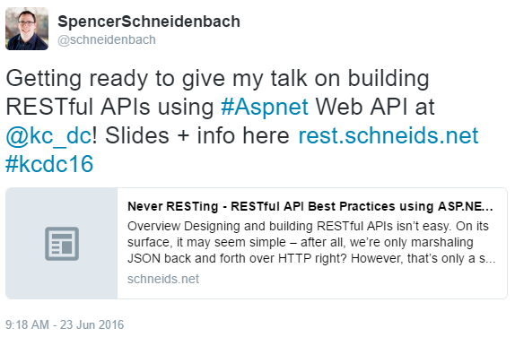
First things first
Slides, links, and more at rest.schneids.net

Slide 4
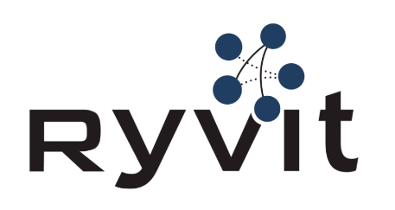
About Me
Platform Architect at Ryvit
Web developer
AngularJS 1/2, ASP.NET, C#
Twitter: @schneidenbach
github.com/schneidenbach
sas.projects@me.com
Website: schneids.net

Slide 5
What is REST?
Representational State Transfer
The architecture of the web
REST is an architectural style, not a protocol or spec
Six constraints
Client-server separation
Stateless
Cacheable
Layered
Code on demand (optional)
Uniform interface

Slide 6
Client-server
Client doesn't care about how data is stored
Server doesn't care about what user interface the client is
Stateless
Persistent state isn’t part of a RESTful architecture
All the state needed is in a request

Slide 7
Cacheable
Response defines whether or not it’s cacheable
Layered
Client doesn’t know whether or not the response comes from
Cache server
Load balancer
The web server itself
Code on demand (optional)
Code can be sent to the client by the server

Slide 8
Uniform interface constraint
Resource identification
Resources are identified via URIs
Representations of the resources are returned
Manipulation of resources via these representations
Update, delete
Self-descriptive
E.g. Content-Type header
Hypermedia as the engine of application state (HATEOAS)
Server provides all of the things required to navigate/change state

Slide 9
What is a RESTful API?
An API that follows REST architecture
Term has been sort of co-opted
REST != JSON
REST != HTTP
Lots of people say “REST API” when they really mean HTTP JSON API

Slide 10
Pragmatic REST
RESTful API != Good API
Be prepared to:
Do what makes sense
Throw out the rest!
Is that vague enough for you?

Slide 11
RESTful API design process
1. Design
Spencer’s two rules
Resource identification
Security
Versioning
Error reporting
2. Implement
Technology stack
Code it!
3. Maintain

Slide 12

Designing your RESTful API
I HAVE ONE RULE… okay I actually have two rules

Slide 13
KISS (or, Keep it Simple, Stupid)

Slide 14
First big rule - KISS
Don’t be creative. A creative API is a bad API.
Provide what is necessary – no more, no less.
Don’t return things the consumer doesn’t need to see.
Use only a handful of HTTP response codes. Don’t use them all.
200 – OK
201 – Created
400 – Bad Request
404 – Not Found
401 – Unauthorized

Slide 15
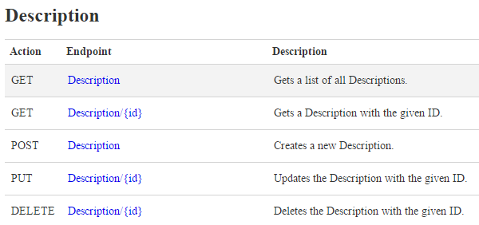
KISS, continued

Slide 16

KISS, continued
Inactive
Deleted
Visible
Retired

Slide 17
Second big rule – Be Consistent
Be consistent with accepted best practices
Be consistent with yourself
Same error codes
Same general structure
Same HTTP principles
GETs should get data
PUTs/POSTs should alter data

Slide 18
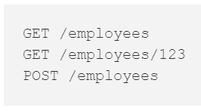
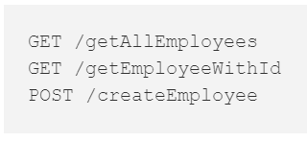
Resource identification
Nouns vs. verbs
Basically, use plural nouns
Sub resources should be identifiable as such
Example: GET /customers/1234/invoices

Slide 19
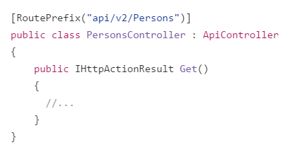
Versioning
Think about versioning ahead of time
Your API should stand a test of time
Versioning strategy?
URL?
Header?
I prefer URL

Slide 20
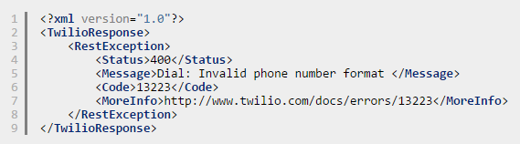
Error reporting
Errors are going to happen
Make it as easy as possible for your consumers to find and fix errors
Avoid returning 500 Internal Server Errors
Good example: I like what Twilio does

Slide 21
Security
Always use SSL
Don’t roll your own!
Lots of existing patterns
Basic
OK over SSL
Vulnerable to man in the middle
OAuth
Authenticate w/ username and password once
Can expire or be revoked
TONS more flexibility vs. basic

Slide 22
Ok, time for some code examples

Slide 23
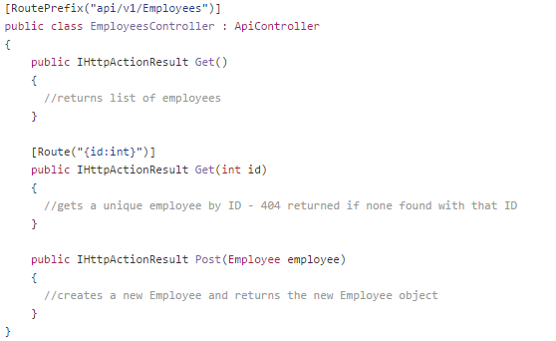
Anatomy of a controller
Inherits from ApiController
Routing via:
Convention
Attributes
GETs, PUTs, POSTs
Defined by method name
Can also use attributes
[HttpPost], [HttpGet]

Slide 24
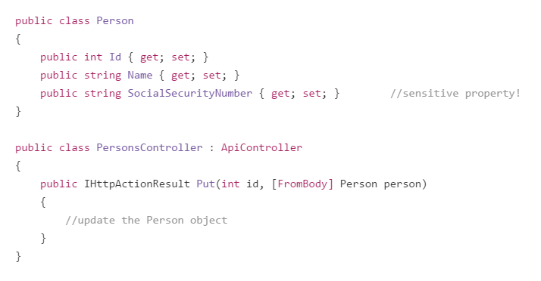
What’s wrong with this code?

Slide 25
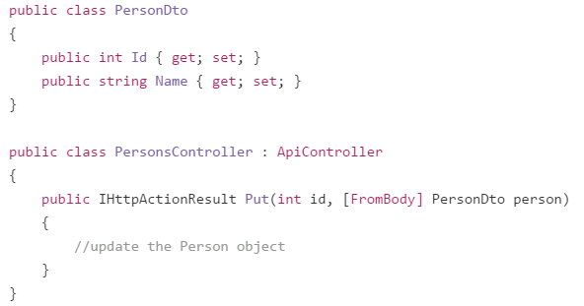
Lesson: Use DTOs

Slide 26
Validation
Built-in validation
IValidatableObject
Attributes
Required
Range
Etc.
Fluent Validation

Slide 27
How can this code be improved?

Slide 28
Lesson: Controllers should be thin
Controllers should know who needs to do something, not how to do it
Maintains a separation of concerns
Much more broken down and testable

Slide 29
How could this code be improved?

Slide 30
Lesson: Use Dependency Injection
Much more testable
Easy to use
Lots of frameworks
Ninject
Autofac
Find one you like and use it!

Slide 31
async/await vs. synchronous

Slide 32
Lesson: Use async/await
Small scale systems – probably doesn’t matter too much
Large scale systems – will make a difference
Synchronous is out. Embrace async/await.

Slide 33
Maintaining your API
Standard stuff – fix bugs, optimize
Don’t introduce breaking changes like removing properties
Vendor: “Hey, we’ve made some under-the-cover changes to our endpoint. It shouldn’t impact you, but let us know if it breaks something.”
Us: ”Okay. Can you release it to test first so we can run our integration tests against the endpoint and make sure everything works?”
Vendor: ”Well, actually we need it ASAP, so we’re releasing to prod in an hour.”

Slide 34
Document, document, document!
Good documentation is essential
Need to know:
How endpoints are accessed
Required/optional parameters
Representation schema
Potential gotchas/errors

Slide 35
Questions?

Slide 36

Thank you!
Slides at rest.schneids.net
Please:
Rate my talk on SpeakerRate!
Follow me on Twitter!
Website: schneids.net
Twitter: @schneidenbach
github.com/schneidenbach
sas.projects@me.com

